Slide 1
DC COURSE PROJECT
TEAM MEMBERS:-
SUMANTH RAO
PRATEEK SHETTAR
JEEVAN GOWDA
YATIRAJGOUDA PATIL

Slide 2
PROBLEM STATEMENT:-
DESIGN AND IMPLEMENT A DIGITAL SYSTEM TO FILL THE N NUMBER OF COLD DRINK BOTTLES CONTINUOSLY SUCH THAT IN ONE HOUR MACHINE CAN FILL 60 LITRES OF COLD DRINK.
FEATURES AND SPECIFICATIONS GIVEN:-
TOUCH / SWITCH BASED INPUT -> SWITCH
SIZE OF BOTTLE -> 500ML
DIGITAL DISPLAY-> COMMON ANODE

Slide 3
UNDERSTANDING THE PROBLEM STATEMENT:
THE PROBLEM STATEMENT DESCRIBES THE NEED TO DESIGN DIGITAL SYSTEM THAT CAN FILL A SPECIFIC NUMBER OF COLD DRINK BOTTLES CONTINUOUSLY. THE SYSTEM SHOULD HAVE A SWITCH INPUT THAT ALLOWS THE USER TO SELECT THE NUMBER OF BOTTLES THEY WANT TO FILL.WE HAVE TO GENERATE CLOCK SIGNAL FOR CALCULATED TIME PERIOD .THE GIVEN TIME TO FILL 60LITRES OF COLD DRINK IS ONE HOUR , BECAUSE OF THE BOTTLE SIZE IS 500ML SO THE TOTAL BOTTLES REQUIRED TO FULL FILL THE NEED OF STATEMENT
(THAT IS 60 LITRES ) 120. 30 SECOND IS REQUIRED TO FILL ONE BOTTLE.
COMPONENTS REQUIRED: cost
1) BREADBOARD --->> 1 → 80
2) SWITCH --->> 1 -> 10
3) 7 SEGMENT DISPLAY --->> 3 -> 30
4) IC: 7447 --->> 3 -> 20
5) IC: 7490 --->> 3 -> 40
6) IC: 555 --->> 1 -> 25
7) REGISTORS ->10
8) SINGLE STRANDED WIRES -> 50
9) POWER SUPPLY ->1200
10) PRINTED CIRCUIT BOARD(PCB) -> 100
TOTAL COST OF THE CIRCUIT = 500

Slide 4
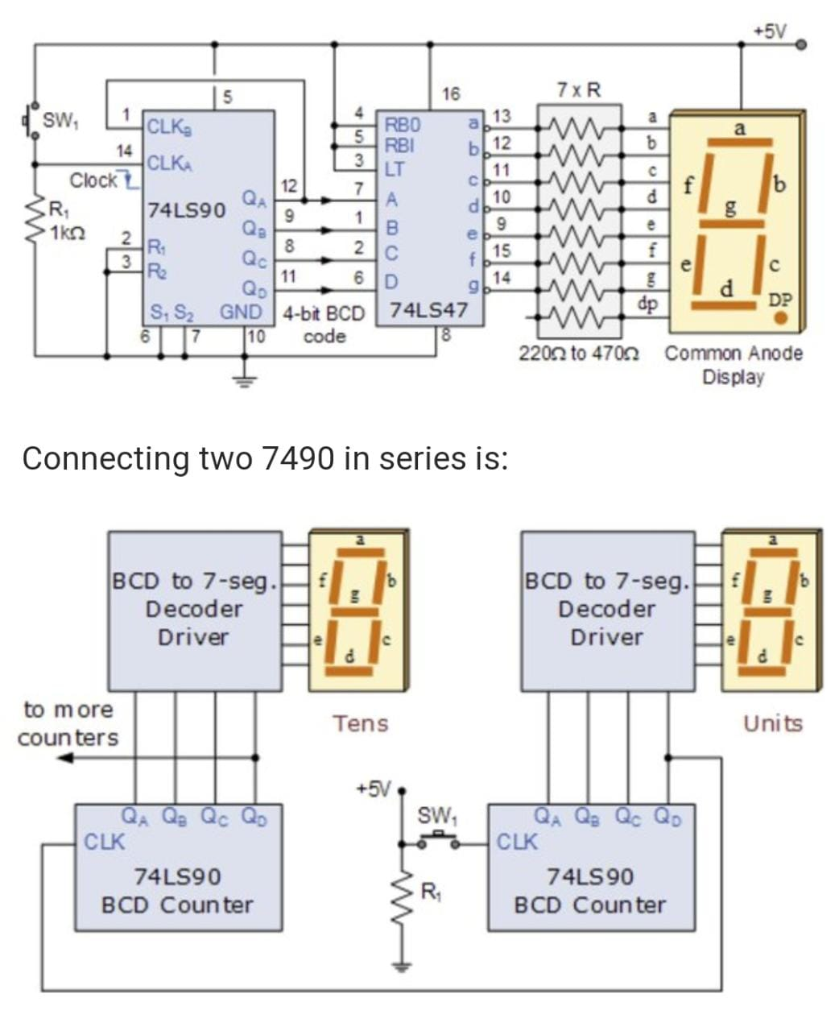
CIRCUIT DIAGRAM

Slide 5
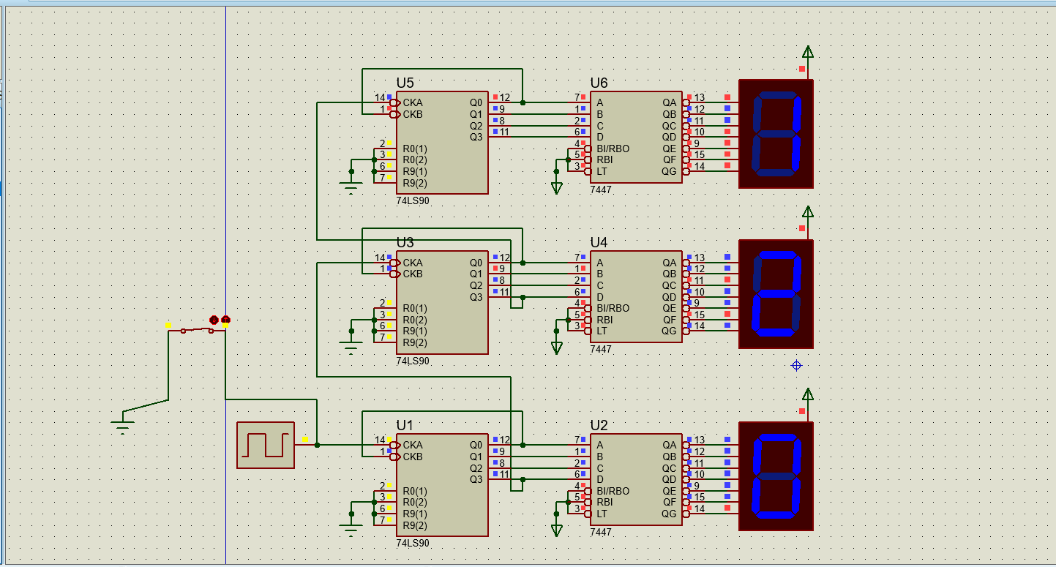
SIMULATION RESULTS

Slide 6
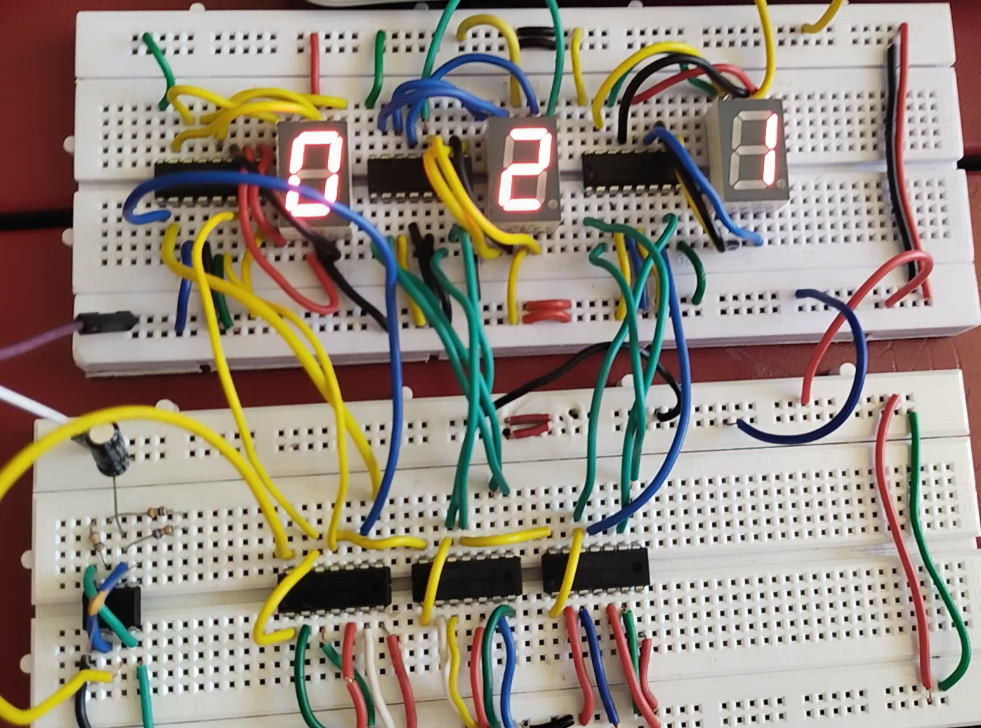
HARDWARE RESULTS

Slide 7
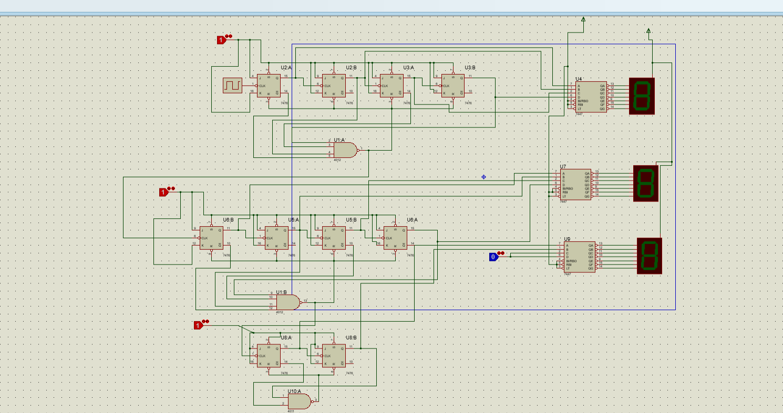
ALTERNATE DESIGN

Slide 8
THANK YOU….

